Slide 1
Data Mining
Project
Predicting Student Performance Using Data Mining Techniques
Group Members: Smit, Krishn, Vishal, Eshwar
Dr. Yibai Li
Data Mining (BUAN 572)

Slide 2
Agenda
1. Business Understanding
2. Data Understanding
3. Data Preparation
4. Modeling Approach
5. Evaluation and Results
6. Managerial Implications
7. Conclusion
8. Q&A

Slide 3
Business Understanding
Objective: Predict students' average score and pass/fail outcome.
Business Relevance: Early interventions and improved academic support.
Helps institutions identify patterns for success.

Slide 4
Problem Statement & Goals
Use data mining to predict academic performance outcomes.
Regression: Predict average score.
Classification: Predict pass/fail outcomes.

Slide 5
Hypotheses
Students completing test preparation perform better.
Parental education level positively impacts scores.
Demographics may influence academic outcomes.

Slide 6
Dataset Overview
1000 student records with demographic and academic details.
Variables: Gender, Race, Parental Education, Scores, Lunch Type.
Cleaned and preprocessed for modeling.

Slide 7
Target Variables
Regression target: average_score (continuous).
Classification target: pass_fail (binary).
Derived from math, reading, and writing scores.

Slide 8
Data Preparation - Derived Variables
Computed average_score = (math + reading + writing)/3.
New variables improve model focus.
pass_fail = 'pass' if average >= 60, else 'fail'.

Slide 9
Data Preparation - Cleaning & Transformation
No missing or duplicate values.
Nominal to numerical conversion performed.
Used 70/30 split for training and testing datasets.

Slide 10
Feature Selection & Correlation
Selected relevant attributes based on correlation.
Strong predictors: test preparation, parental education.
Avoided multicollinearity.

Slide 11
Tools Used
Platform: RapidMiner 5.
Operators: Nominal to Numerical, Set Role, Split Data, etc.
Visual workflows enabled transparent model design.

Slide 12
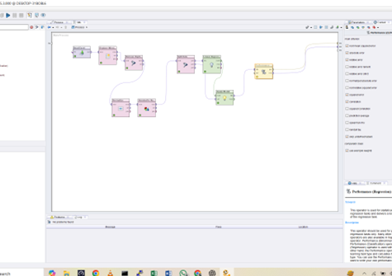
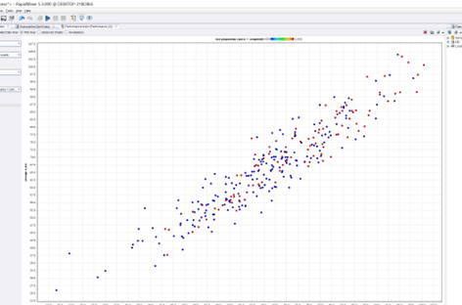
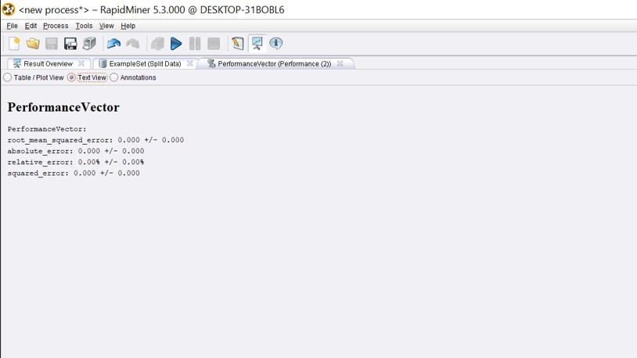
Regression Modeling - Linear Regression
R², RMSE, Absolute, and Relative error = 0%, Near perfection.
Scatterplot shows strong diagonal line, which indicates a high correlation and near-perfect prediction.
Useful for understanding linear relationships.
Very High Accuracy – Model fits data perfectly
Possible Issue: Model may have been tested on training data

Slide 13
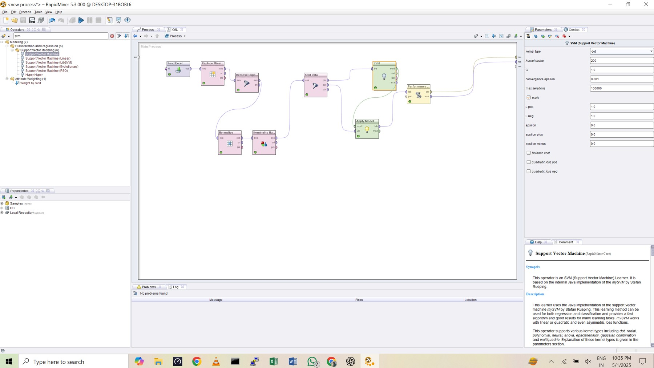
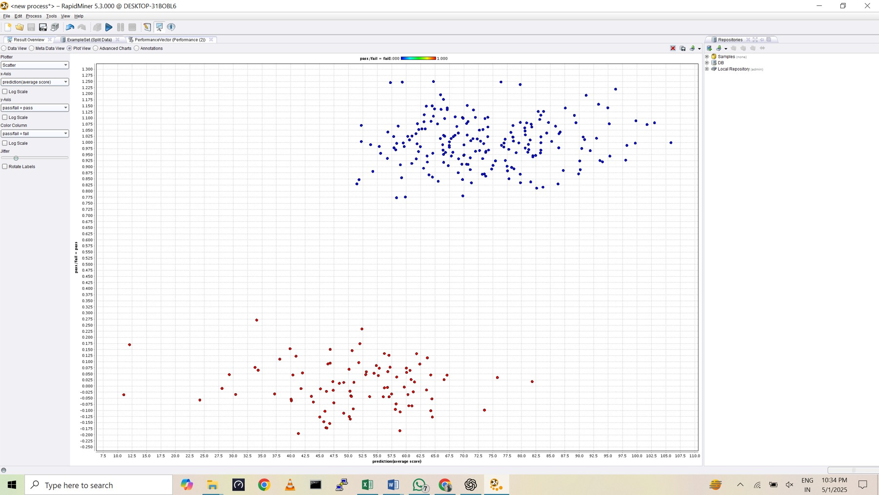
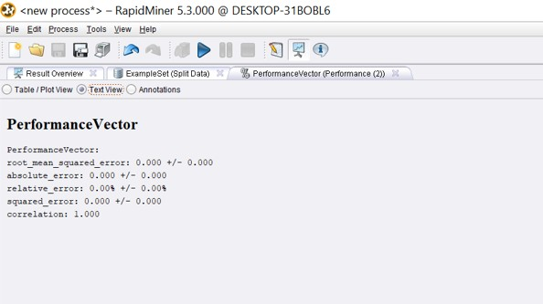
Regression Modelling – SVM
X-axis: Predicted average score
Y-axis: Binary classification output (Pass = 1, Fail = 0)
Blue points: Correctly predicted Pass
Red points: Correctly predicted Fail
Clear separation between pass and fail classes.
Root Mean Squared Error (RMSE): 0.000
Absolute Error: 0.000
Relative Error: 0.00%
Squared Error: 0.0
Indicates perfect regression fit on the dataset.
Strong predictive accuracy, but may signal overfitting—needs further validation.
Correlation: 1.000

Slide 14
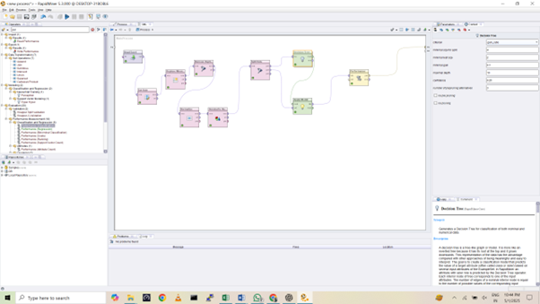
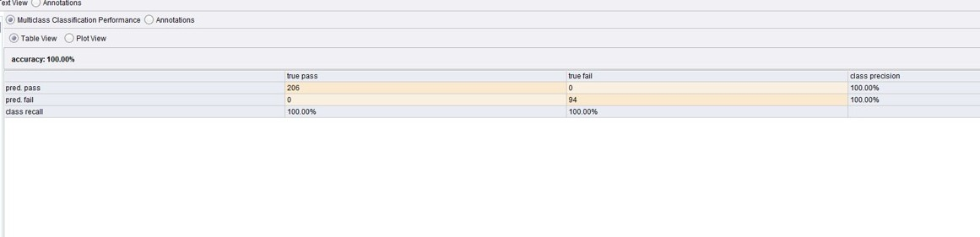
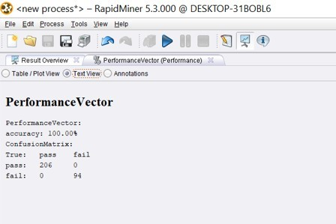
Classification Modeling - Decision Tree
Accuracy, Precision, Recall: 100%.
Visually interpretable decision-making logic.
Used for understanding rules affecting performance.
Result: Pass: 206 and Fail: 94.

Slide 15
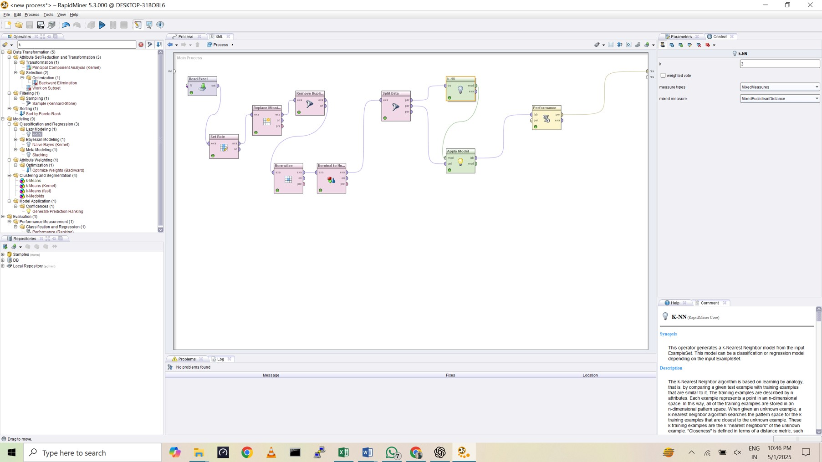
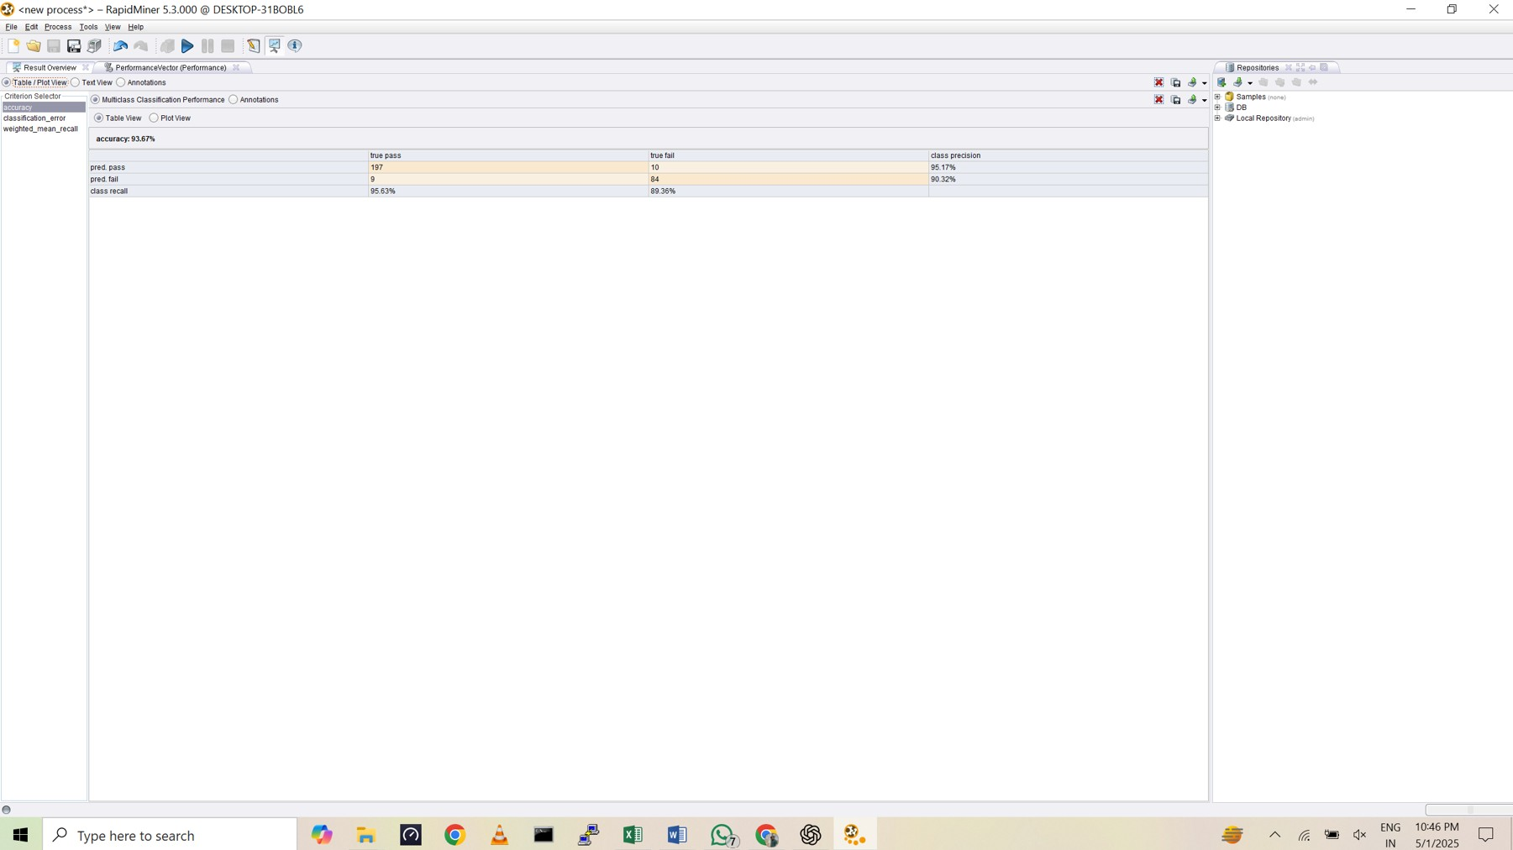
Classification Modeling – k-NN
k-NN: Classification with k = 3
Accuracy: 93.67%
Class Precision (Pass): 95.17%
Class Recall (Pass): 95.63%
Class Precision (Fail): 90.32%
Class Recall (Fail): 89.36%
 | Predicted: Pass | Predicted: Fail
True: Pass | 197 | 10
True: Fail | 9 | 84

Slide 16
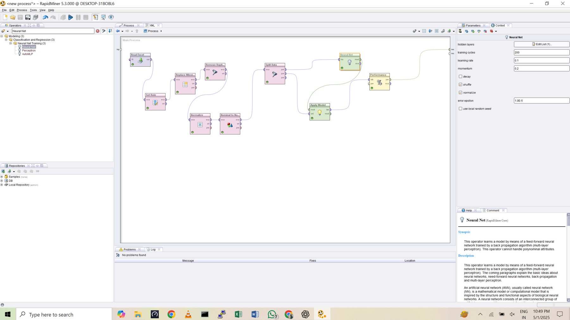
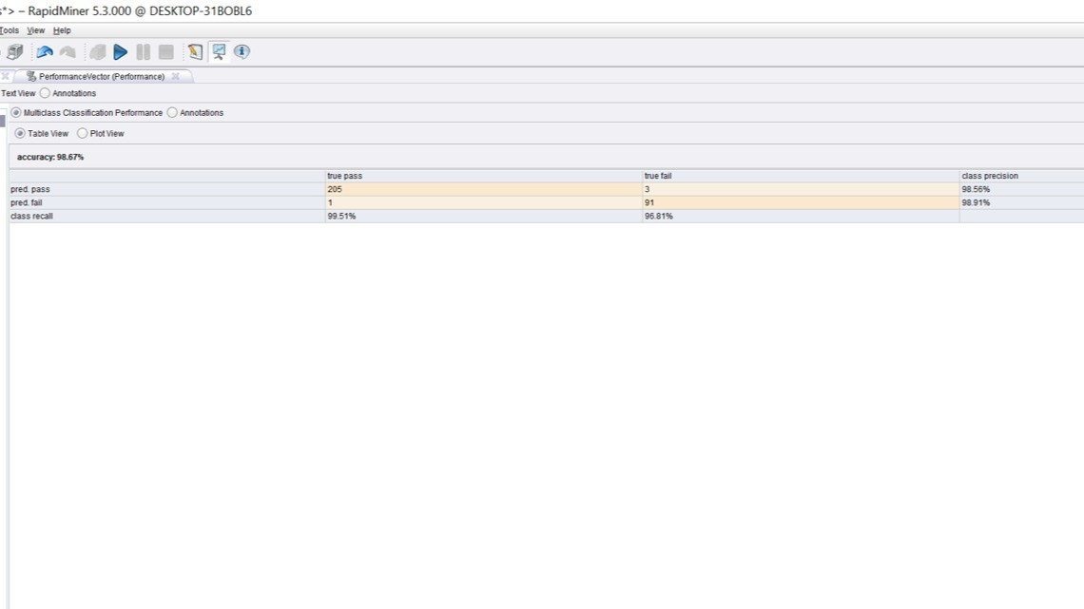
Classification Modeling –
Neural Net- ANN
Accuracy: 98.67%
Precision (Pass): 98.56%
Recall (Pass): 99.51%
Precision (Fail): 98.91%
Recall (Fail): 96.61%
ANN model achieved highest accuracy among tested models
Very low misclassification rate: only 3 Pass and 1 Fail misclassified
Excellent balance between precision and recall
Neural Network provides robust and highly accurate classification
Well-suited for complex patterns in student performance data

Slide 17
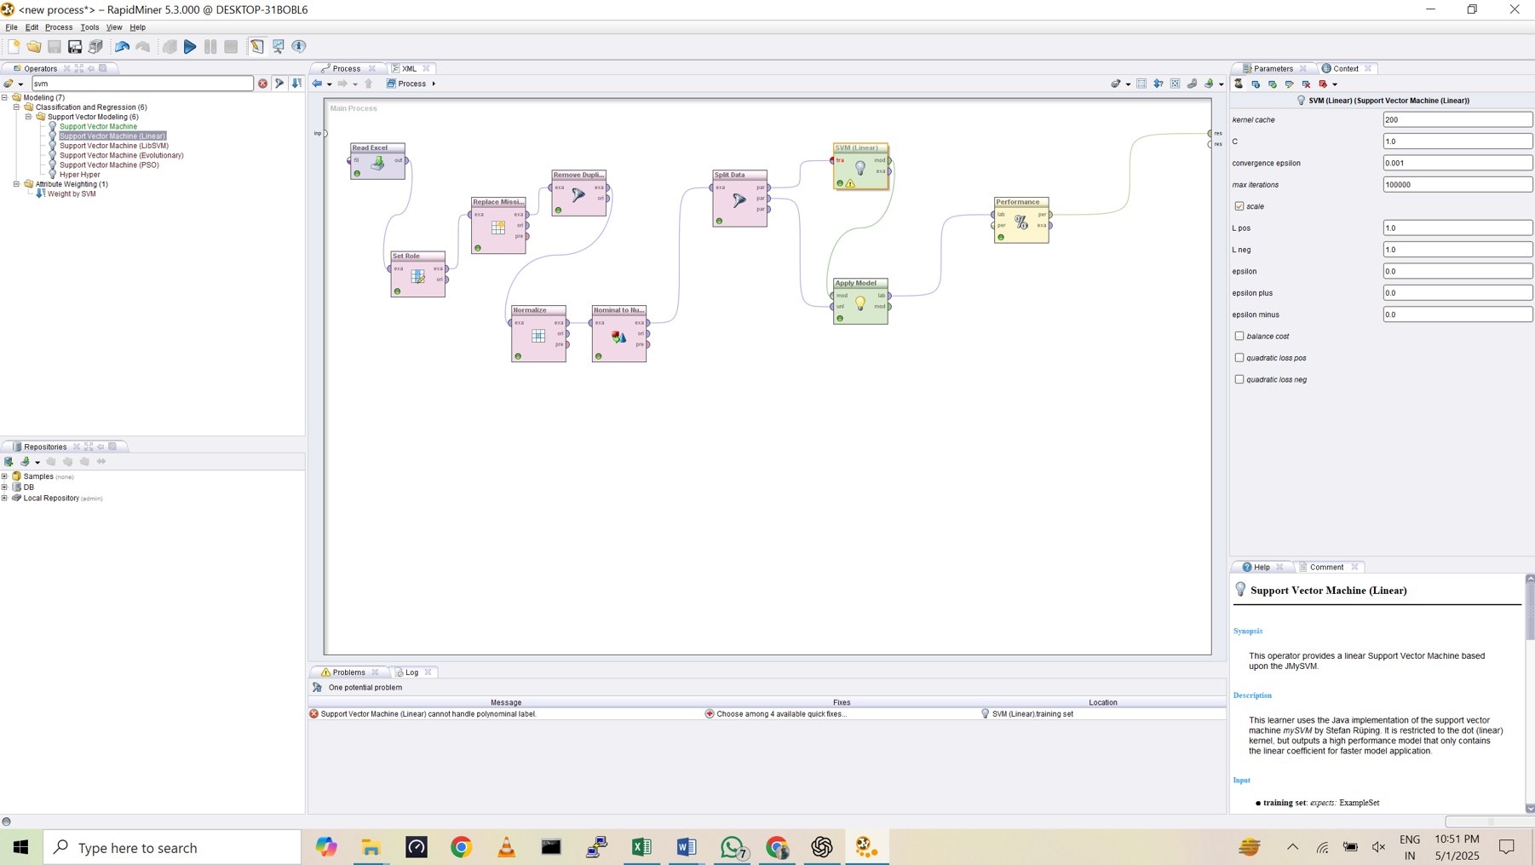
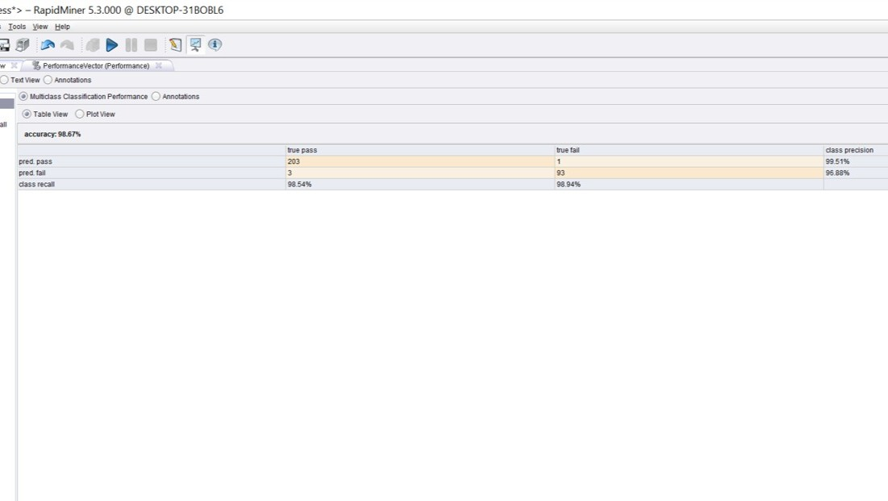
Classification Modeling –
SVM
Accuracy: 98.67%
Precision: Pass: 99.51%, Fail: 96.88%
Recall: Pass: 98.54%, Fail: 98.94%
The model achieved very high accuracy and recall.
Precision is balanced across both classes.
Performs well despite slight class imbalance.
Solution: Converted label attribute to binominal format.
Issue: “SVM (Linear) cannot handle polynomial label.”

Slide 18
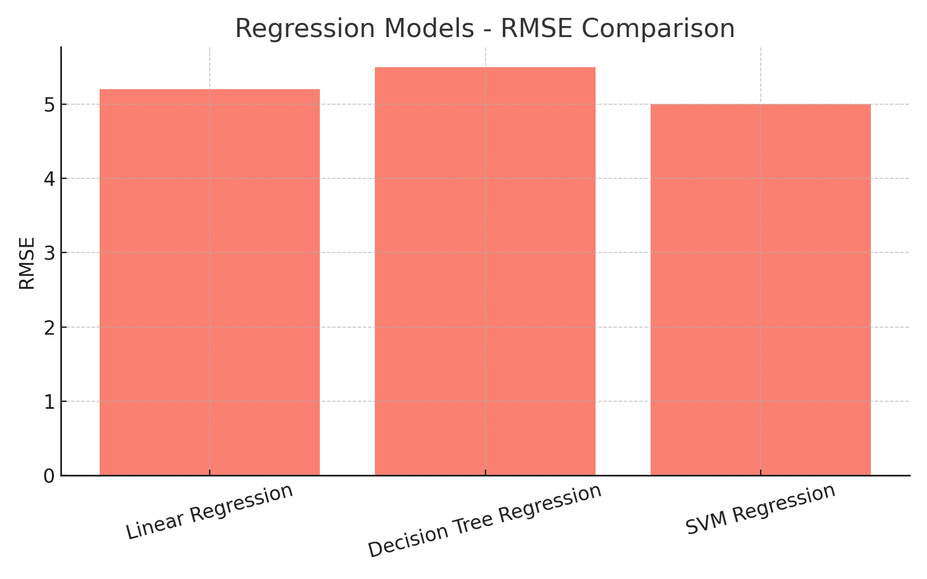
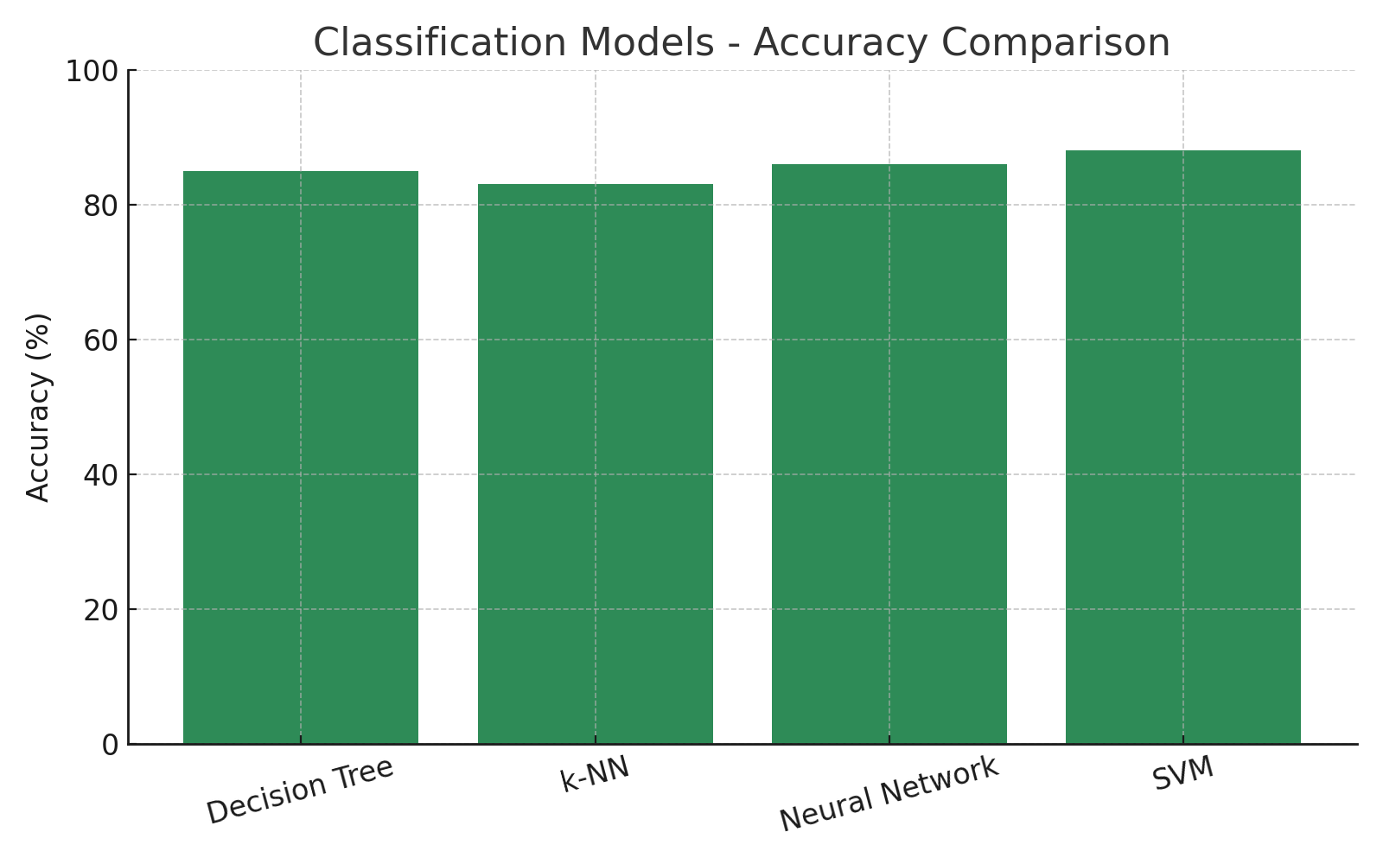
Model Comparison Chart

Slide 19
Application & Use Cases
Detect students at risk early.
Personalized academic assistance.
Better institutional planning and performance.

Slide 20
Managerial Implications
Test preparation significantly boosts outcomes.
Parental involvement should be encouraged.
Tailor strategies based on demographic insights.

Slide 21
Conclusion
SVM was best overall performer.
Predictive modeling supports data-driven education.
Scope for continuous model updates and scaling.

Slide 22
Q&A
- Thank you for your attention!
- We welcome your questions.

